Slide 1
COMMONWEALTH OF MASSACHUSETTS
Charles D. Baker, Governor
Karyn Polito, Lt. Governor
Matthew A. Beaton, Secretary
Judith Judson, Commissioner
The Green Communities Division Partnering with Massachusetts
Cities and Towns
Jim Barry
Western Mass Regional Coordinator
Jim.Barry@State.MA.US
(413) 755 - 2232
January 2019

Slide 2
GREEN COMMUNITIES DESIGNATION and GRANT PROGRAM
Provides grants to qualifying communities to fund energy efficiency initiatives, renewable energy, innovative projects
Qualification Criteria
Adopt as-of-right siting, in designated locations, for RE/AE generation, or RE/AE R&D, or RE/AE manufacturing
Adopt expedited (12 month) application/permitting process
Establish an energy use baseline with a plan to reduce baseline by 20% in 5 years
Purchase only fuel-efficient vehicles
Require new residential construction and new commercial and industrial real estate construction to minimize life-cycle energy costs (Adopt Stretch Code - 780 CMR 115, Appendix AA)
http://www.mass.gov/eea/energy-utilities-clean-tech/green-communities/gc-grant-program/

Slide 3
Criteria 1 – As-Of-Right Siting
Adopt as-of-right siting,
in designated locations,
for Renewable Energy Generation,
OR for RE Manufacturing,
OR for RE Research and Development
Site Plan Approval and ConCom review still applicable
but NO Special Permits
Designated locations means NOT everywhere in town
RE = Renewable Energy (Solar PV, Wind, Wave)
AE = Alternative Energy (Biomass Combined Heat & Power)
Many small towns use a Solar Overlay District that includes only town owned property

Slide 4
Criteria 2 – Expedited Permitting
12 months: date of initial application to date of final approval
Applies only to the proposed facilities subject to the as-of-right siting provision.
Can apply the MGL c 43D permitting process to these zoning districts
OR letter from Town Counsel affirming nothing precludes an answer within 12 months
Pretty simple to get a letter from Town Counsel

Slide 5
Criteria 3 – Energy Baseline
Establish Energy Use Baseline
and Adopt a 5 Year Plan to reduce it by 20%
Includes all Municipal Buildings, Vehicles, Street and Traffic Lights
You can use new Mass Energy Insight
Or Energy Star Portfolio Manager or other tools
The Baseline Year can go back 2 years (to FY 2017)
Comprehensive 5 year plan to reduce that baseline usage by 20 %

Slide 6
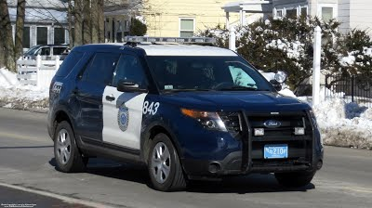
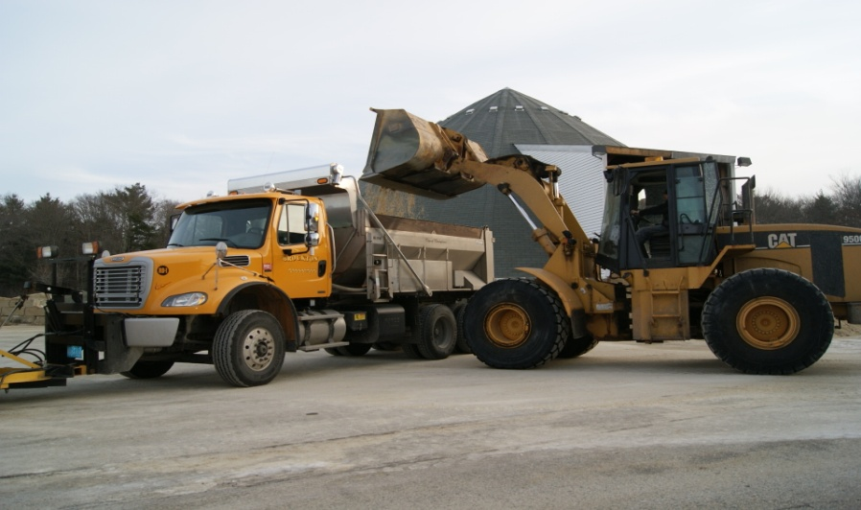
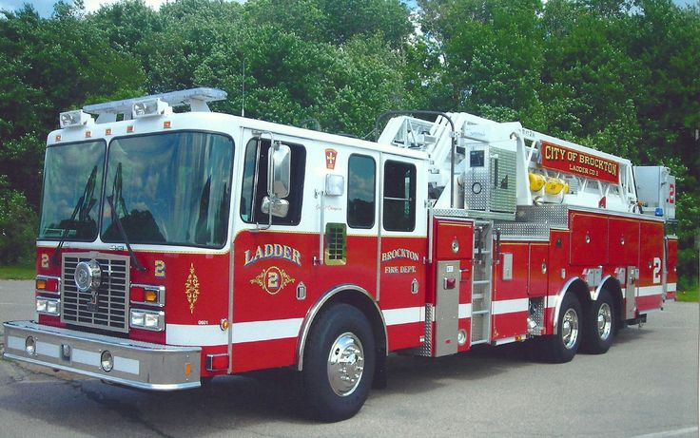
Criteria 4 – Fuel Efficient Vehicles
Purchase only fuel-efficient vehicles for municipal use whenever such vehicles are commercially available and practicable.
Police cruisers are exempt until
commercially available.
Heavy-duty vehicles > 8,500 pounds are exempt.
Pick Up Trucks: 2wd = 17mpg; 4wd= 16 mpg
Cars 2wd = 29 mpg; 4wd = 24 mpg

Slide 7
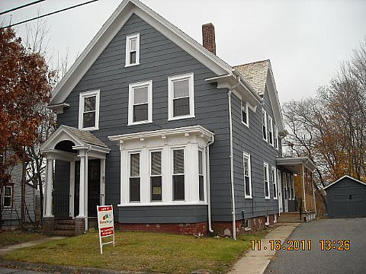
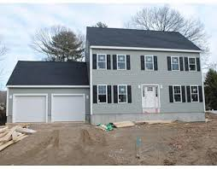
Criteria 5 – Minimize Life Cycle Costs
Require all new residential construction and all new commercial and industrial real estate construction to minimize, to the extent feasible, the life-cycle cost of the facility by utilizing energy efficiency, water conservation and other renewable or alternative energy technologies.
The DOER recommended way for cities and towns to meet this requirement is by adopting the BBRS Stretch Code (780 CMR 115.AA) an appendix to the MA State Building Code.
In a town, the Stretch Code must be adopted as a general bylaw by its Town Meeting.

Slide 8
Stretch Code old MIS-conceptions
‘Stretch Code is new and experimental.’
No; It is based on Energy Star for Home
.
‘Stretch Code requires tight unhealthy homes’
No; Building science has evolved
‘Homes w/ oil heat can’t meet the Stretch Code’
No; It is easier to meet SC with gas, but ...
‘Town residents will be required to update their
existing homes’
No; New Stretch Code only applies to NEW residential construction and explicitly exempts additions, renovation & repairs

Slide 9
The Stretch Code is no longer much of a Stretch
A few years ago, the Stretch Code WAS a bit of a stretch compared to the base energy code (IECC 2009).
But on July 1, 2014 a new base energy code (IECC 2012) took effect. It required blower door tests and increased insulation levels in walls and attics. Your town had operated under that more energy efficient code for 4 years
That base code “caught up” with the Stretch Code and some builders say that the Stretch Code was ‘easier’ to comply with than that 2012 Code (insulation levels for example…)

Slide 10
The Stretch Code is no longer much of a Stretch
January 1, 2017 – there is now a NEW base energy code (IECC 2015) and an associated NEW Stretch Code which is almost NO Stretch at all.
Basic difference in cost is for a HERS Energy Rater which is required by Stretch Code for new residential construction. Total additional costs are between $1,600 and $3,000 for typical single family home. MassSave rebate covers most of this extra cost: $1,300 - $1,700.
And home owner receives annual energy cost savings year after year after year.

Slide 12
Green Communities Designation and Grant Program
Grant allocations based on a $125K minimum
plus a population/per capita income formula
Projects being funded include electric and thermal (natural gas and fuel oil) energy saving projects, incremental costs for hybrid vehicles and grant administration costs.
TOWN POPULATION GRANT
Colrain 1,600 $ 129,880
Shelburne 1,800 $ 132,575
Greenfield 17,400 $ 666,430 (4)
Gill 1,500 $ 208,365 (2)
Bernardston 2,000 $ 131,290
12

